Slide 1
Patterns of Patterns
And why we need them

Slide 2
A peek inside
The misery of having thousands of patterns.
Local and distributed architectures are not dissimilar.
Structure determines function.
There are only so many elementary geometries.
Which means that hundreds of patterns condense into several metapatterns.

Slide 3
Expectation vs Reality

Slide 4
What we were promised 30 years ago
Patterns as a ubiquitous language of software architecture.
Patterns as vessels for sharing and recording experience.
A pattern language as a construction set for software engineering.
There are too many patterns for any person to remember. Some patterns names are ambiguous.
Patterns are regularly reinvented or plagiarized, breaking the continuity of experience and debarring the sharing of knowledge between domains.
A few specialized pattern languages became widespread. No attempt at a generic pattern language has ever succeeded.
Notes:
The promises were taken from the Gang of Four book and first volumes of Pattern-Oriented Software Architecture.
The successful specialized pattern languages are the Gang of Four Design Patterns (a mix of GUI and general-use patterns), Enterprise Integration Patterns (communication in complex asynchronous distributed systems), and Domain-Driven Design (organization of development for enterprises).

Slide 5
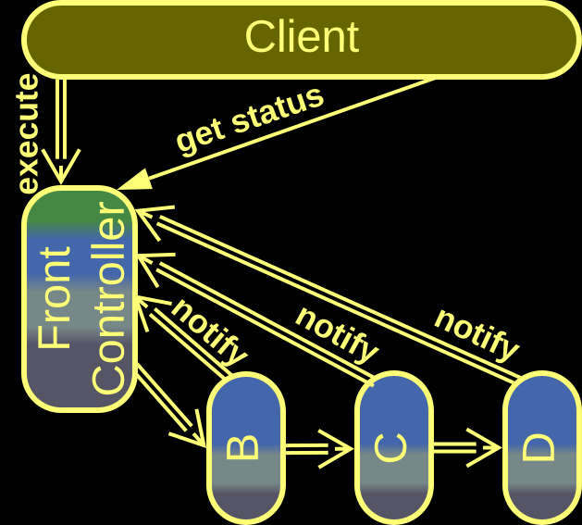
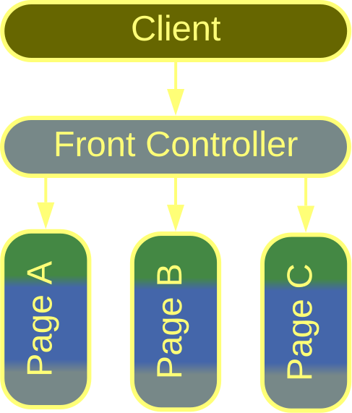


Which is the Front Controller
Neal Ford and
Mark Richards, 2021
Martin Fowler at al., 2002
?
A service that tracks the status of requests by receiving notifications from a Pipeline.
A part of a backend MVC which parses client requests and calls page classes.
Is Mark Richards wrong? He is the author of the most modern anthology of architectural styles!
There are over 2000 patterns! No one can remember them!
Notes:
https://metapatterns.io/analytics/ambiguous-patterns/#front-controller

Slide 6
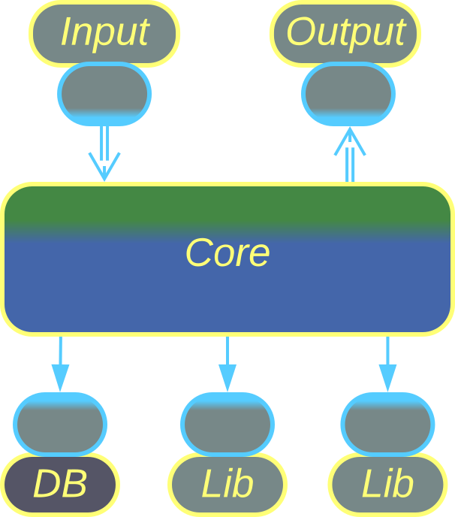
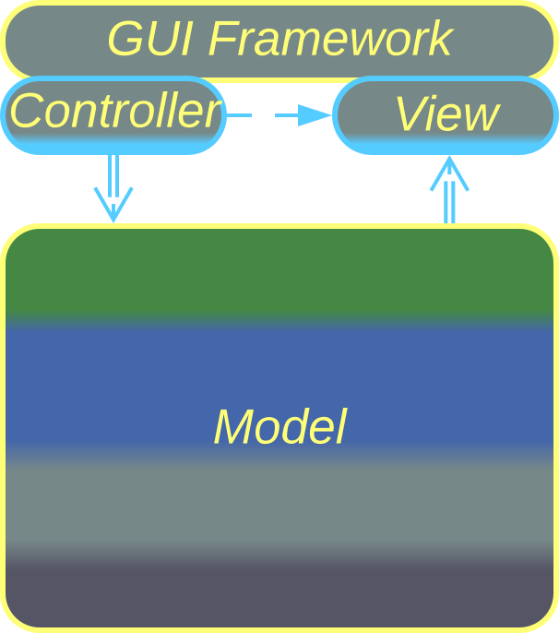
Patterns are reinvented…
Hexagonal Architecture
(Ports and Adapters), Alistair Cockburn,
2005
⇔
Model-View-Controller
(MVC),
Trygve Reenskaug, 1979
Allows for running the same core logic in different setups.
The external components can be changed without affecting the core.
Protection from vendor lock-in.
Supports multiple views of a single model.
The UI can be changed without affecting the model.
Is easy to port to new platforms.
Notes:
https://metapatterns.io/implementation-metapatterns/hexagonal-architecture/#examples--separated-presentation

Slide 7
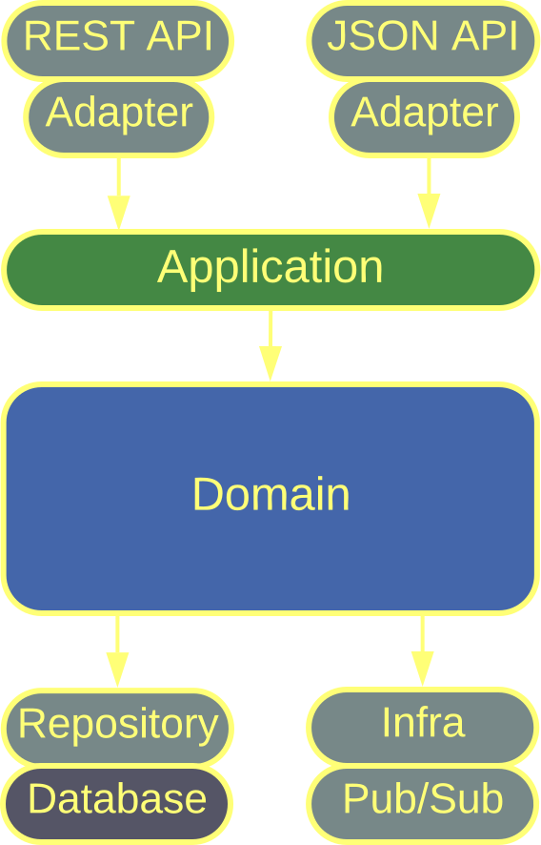
… or plagiarized?
Please find 3 differences between:
– Ports and Adapters (2005) with a DDD-style (2003) layered core.
– Onion Architecture (2008).
– Clean Architecture (2012).
Notes:
https://metapatterns.io/implementation-metapatterns/hexagonal-architecture/#ddd-style-hexagonal-architecture-onion-architecture-clean-architecture

Slide 8
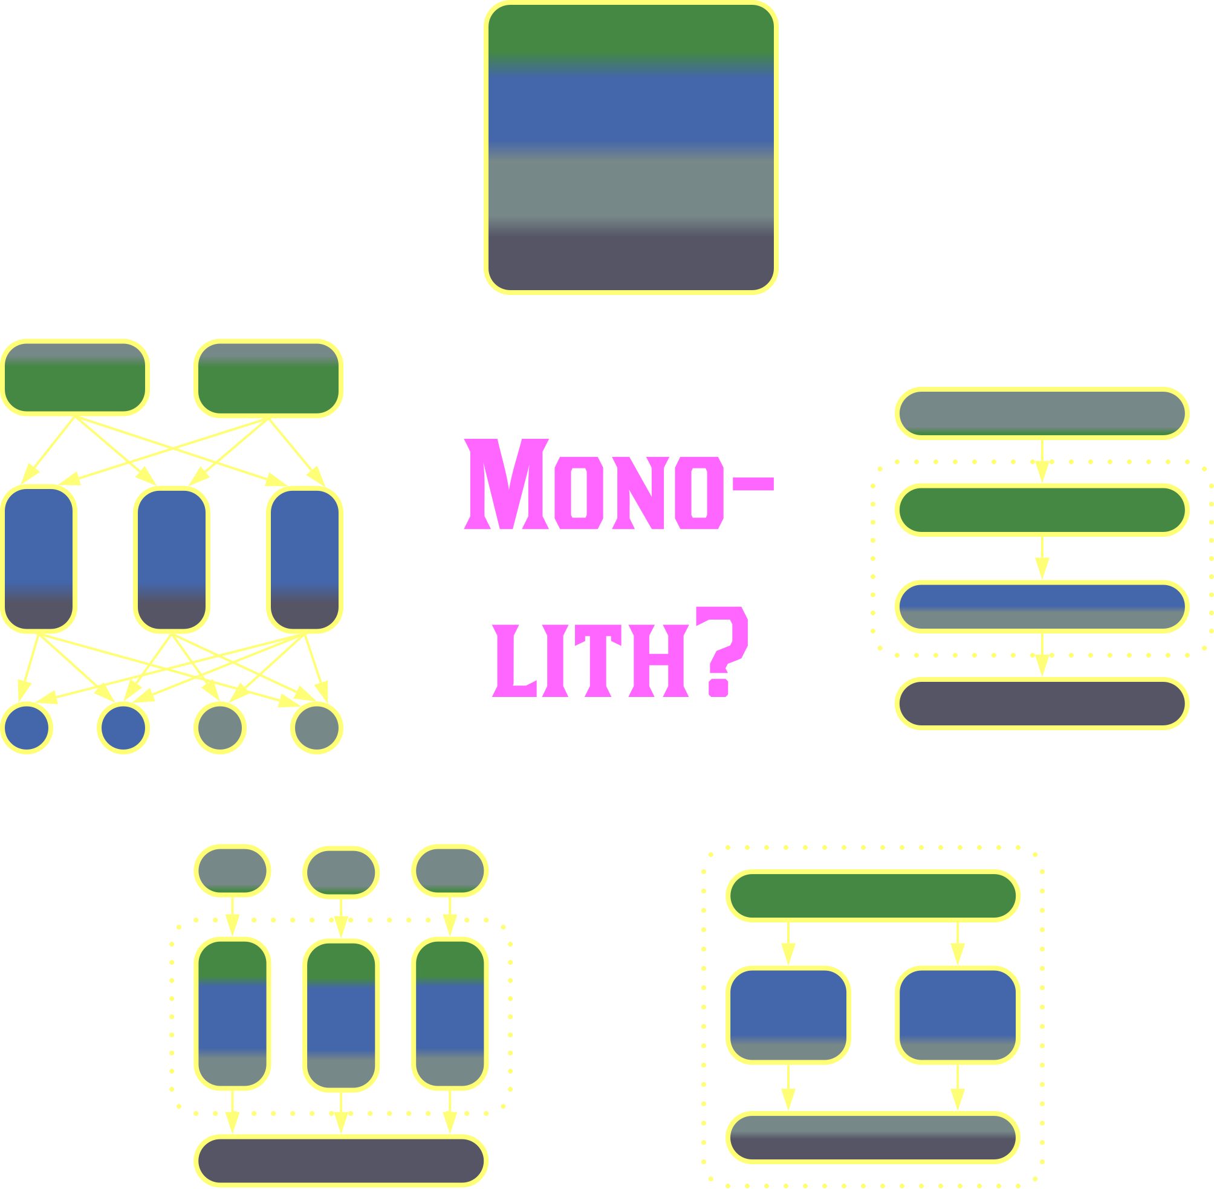
Patterns change their meanings over time
What is a Monolith?
– An unstructured application?
– A non-distributed system?
– A system with a shared database?
– A single unit of deployment?
Notes:
https://metapatterns.io/analytics/ambiguous-patterns/#monolith

Slide 9
Local and Distributed Architectures

Slide 10
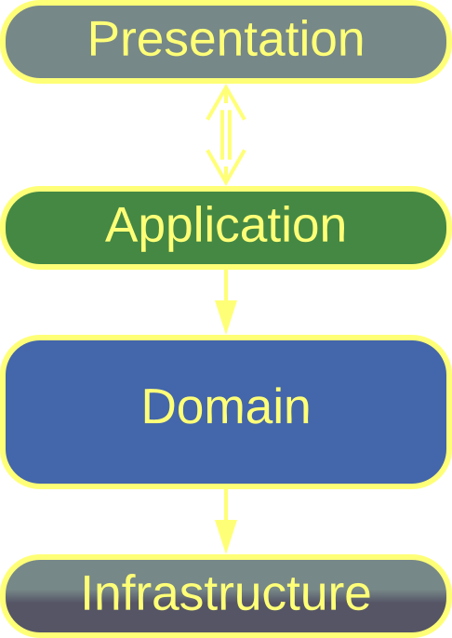
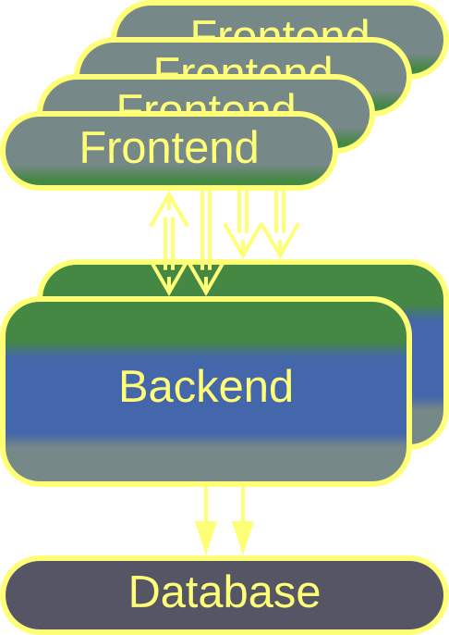
Layers and Tiers
Both Layers and Tiers allow for individual components to:
– Differ in their properties (e.g. responsiveness).
– Differ in technologies (programming language).
– Be developed by dedicated teams.
Both architectures allow for a quick start of development but tend to grow unmanageable if not further partitioned by subdomain.
Layers
3-Tier
Tiers, being a distributed architecture, allow for its components to run on dedicated hardware, scale individually, differ in security, and provide a limited fault tolerance.
Notes:
https://metapatterns.io/basic-metapatterns/layers/

Slide 11
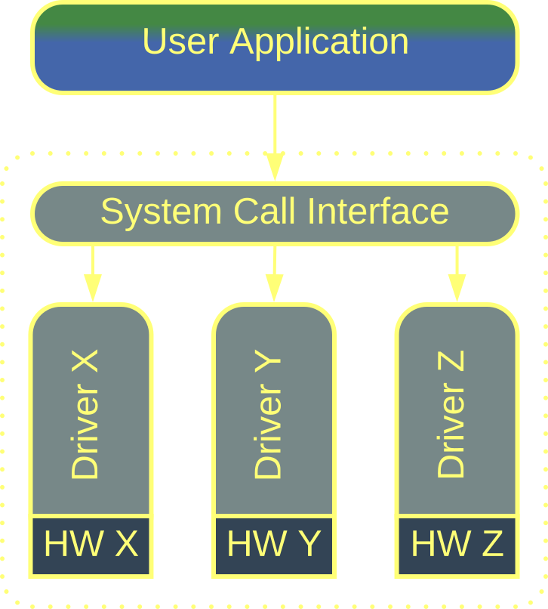
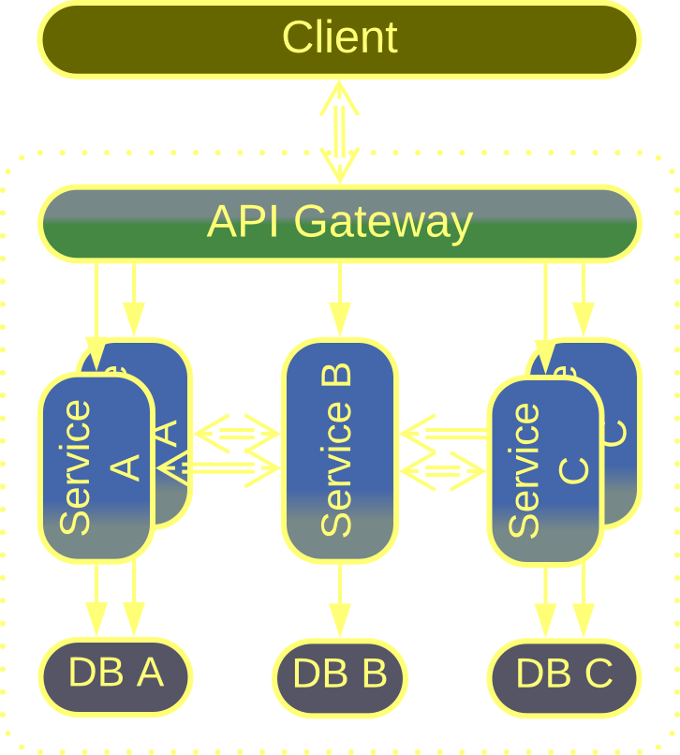
Device Drivers and Microservices
Each device driver and each microservice:
– Covers a whole subdomain.
– Is developed by a dedicated team.
– Has its own code style and technologies.
– Is tested and released independently of others.
Both architectures are dedicated to multi-team development of complex projects but necessarily sacrifice the simplicity and convenience of use cases that involve several subdomains.
OS Drivers
Microservices
Microservices, thanks to their distributed nature, are quite scalable and fault tolerant.
Notes:
https://metapatterns.io/basic-metapatterns/services/

Slide 12
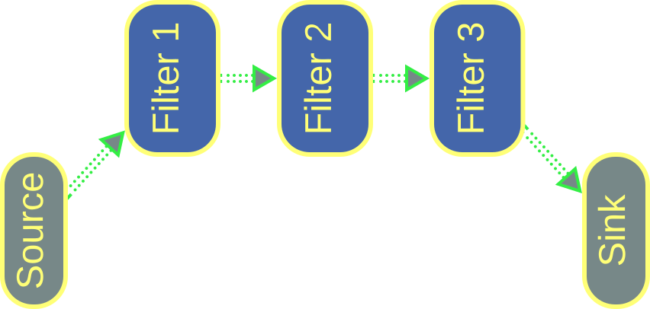
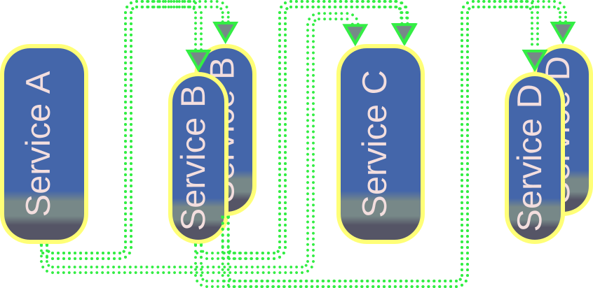
Pipes and Filters and Event-Driven Architecture
Components of Pipes and Filters or Choreographed Event-Driven Architecture:
– Are easy to scale, add or replace without affecting the whole system.
– Can be implemented and tested in isolation through event or data stream replay.
– May differ in technologies.
Both architectures specialize in processing streams of closely related data packets or events.
Pipes and Filters
Event-Driven Architecture
Choreographed Event-Driven Architecture can utilize resources of multiple servers while Pipes and Filters are usually limited to multiple CPU cores of a single workstation.
Notes:
https://metapatterns.io/basic-metapatterns/pipeline/

Slide 13
What have we done?
As we see, once the system properties rooted
in distribution are segregated, whatever remains
of a distributed architecture is identical to
a decades-old pattern for local applications.
Notes:
The continuity of architectures between an unstructured monolithic and distributed systems https://metapatterns.io/basic-metapatterns/monolith/#relations

Slide 14
Patterns of Patterns

Slide 15
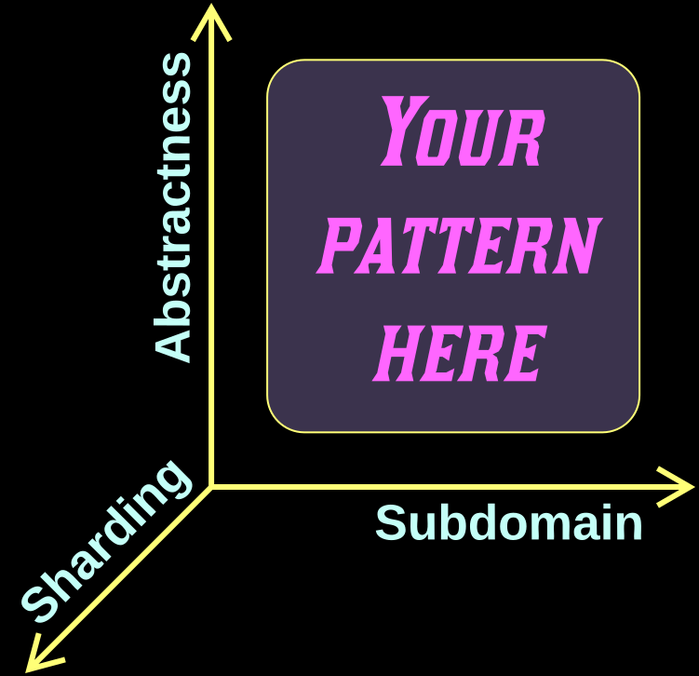
How did we compare architectures?
We drew them with a common system of coordinates:
– Abstractness
– Subdomain
– Sharding
Structure determines function!
Notes:
https://metapatterns.io/introduction/metapatterns/

Slide 16
Metapatterns
A metapattern is a cluster of patterns related in their structure and thus also in their properties

Slide 17
There are few metapatterns
As a metapattern is defined by its structure,
and the structure is a geometry in a 3D space,
there are only so many metapatterns.
Therefore hundreds of patterns are reduced
to several clusters with manifest properties.

Slide 18
The benefits of having a taxonomy of patterns
– A hierarchical classification is easy to learn and study.
– Duplicate or ambiguous entities become obvious.
– Novel solutions may be found through mapping architectures between domains.

Slide 19
Known Metapatterns

Slide 20
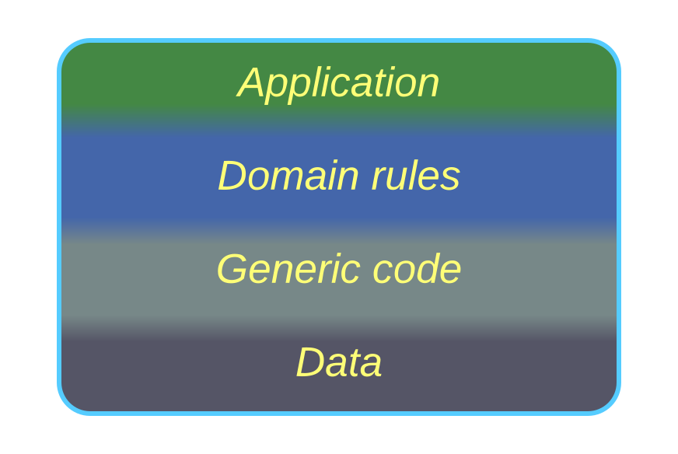
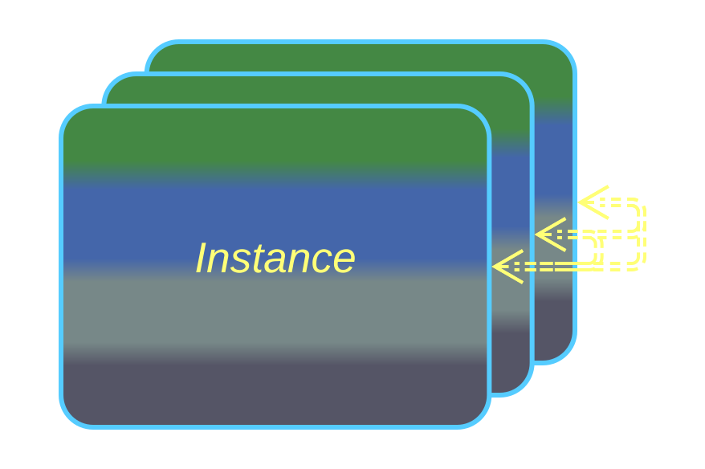
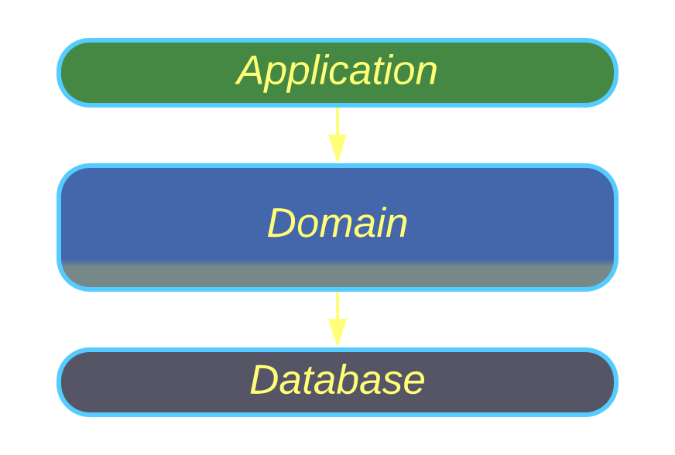
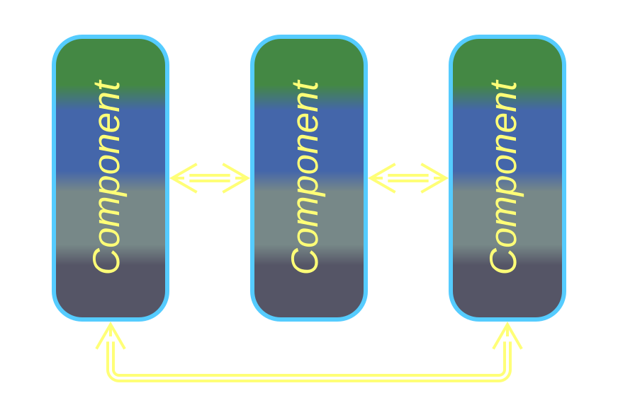
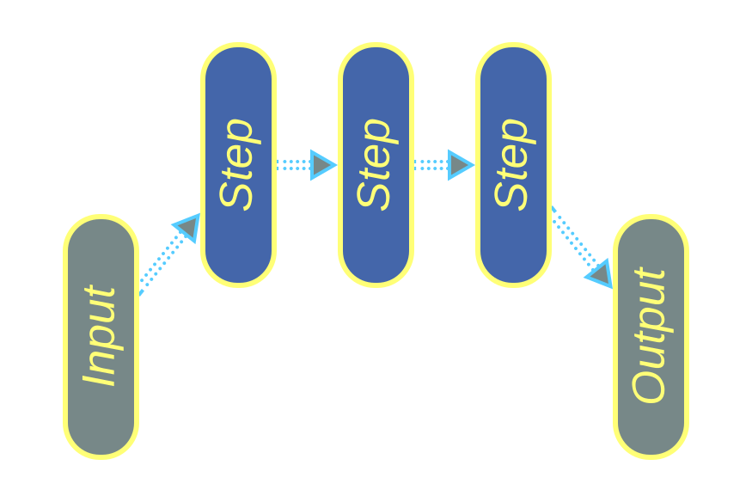
Basic Metapatterns
Monolith | Shards | Layers | Services | Pipeline
Reactor, Proactor, Half-Sync / Half-Async, (Re)Actor-with- Extractors | Shards, Partitions, Instances, Replicas | Layers, Tiers | Service-Based Architecture, Modular Monolith, Microservices, Actors | Pipes and Filters, Choreographed Event-Driven Architecture, Data Mesh
Notes:
These are the building blocks for more complex architectures https://metapatterns.io/basic-metapatterns/

Slide 21
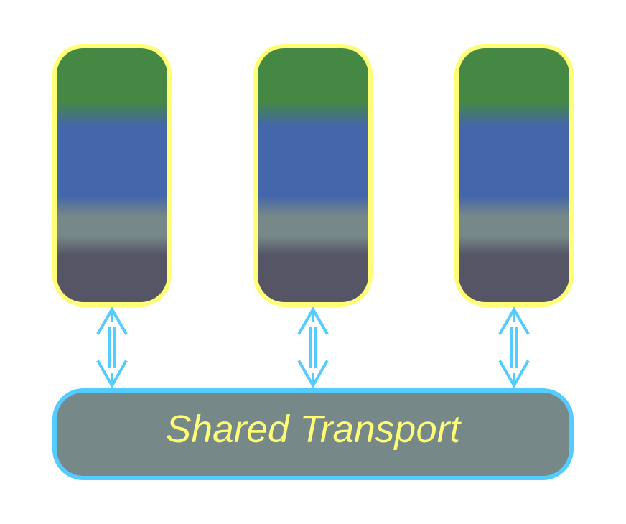
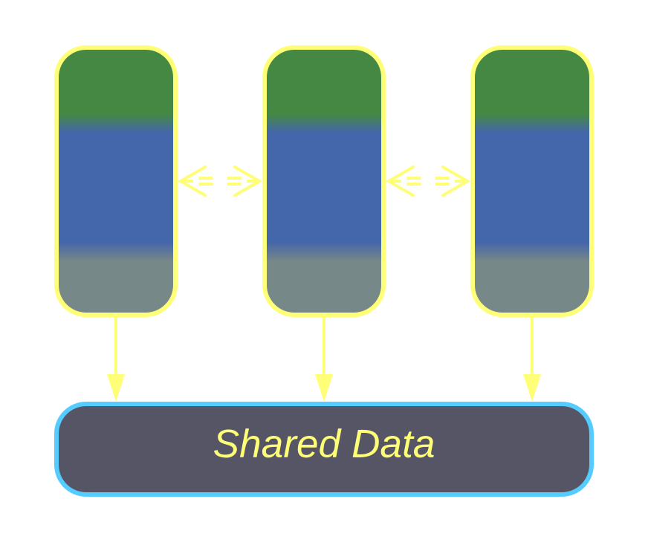
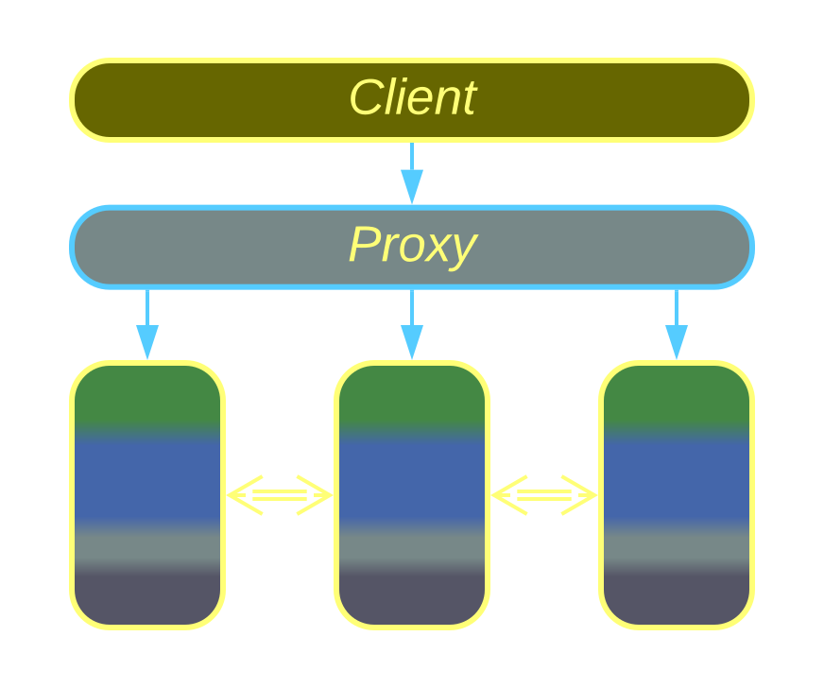
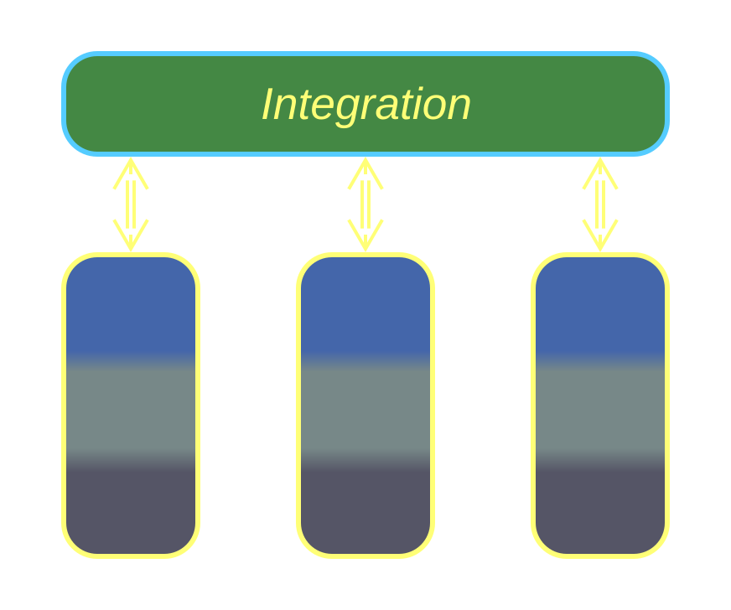
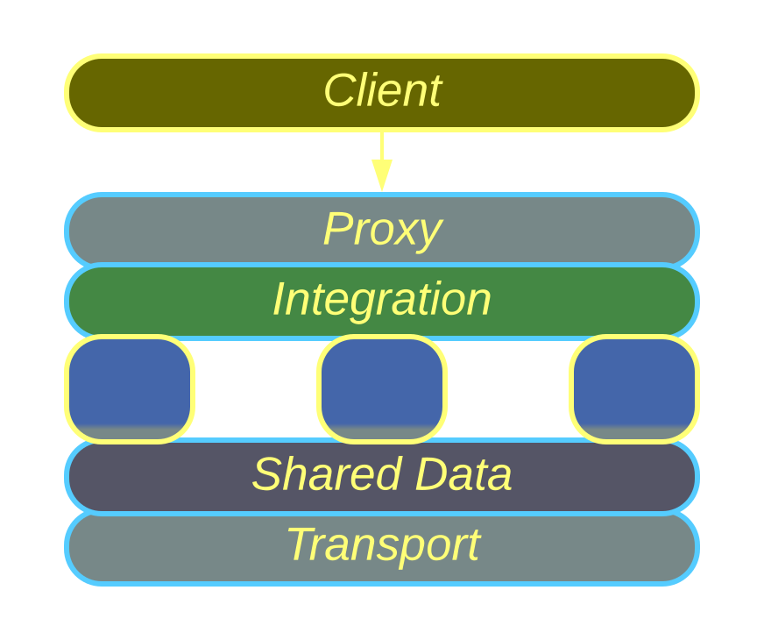
Extension Metapatterns
Middleware | Shared Repository | Proxy | Orchestrator | Combined Component
Message Broker, Deployment Manager | Shared Database, Shared Memory, Shared FS, Blackboard, Data Grid | Firewall, Response Cache, Load Balancer, Reverse Proxy, Adapter, ACL, OAL, HAL, etc. | Mediator, Facade, Scatter-Gather,Process Manager, Saga, Transaction Script | Message Bus, API Gateway, Event Mediator, ESB, Service Mesh, Space-Based Architecture
Notes:
A system-wide layer implements cross-cutting concerns for other components dedicated to business logic https://metapatterns.io/extension-metapatterns/

Slide 22
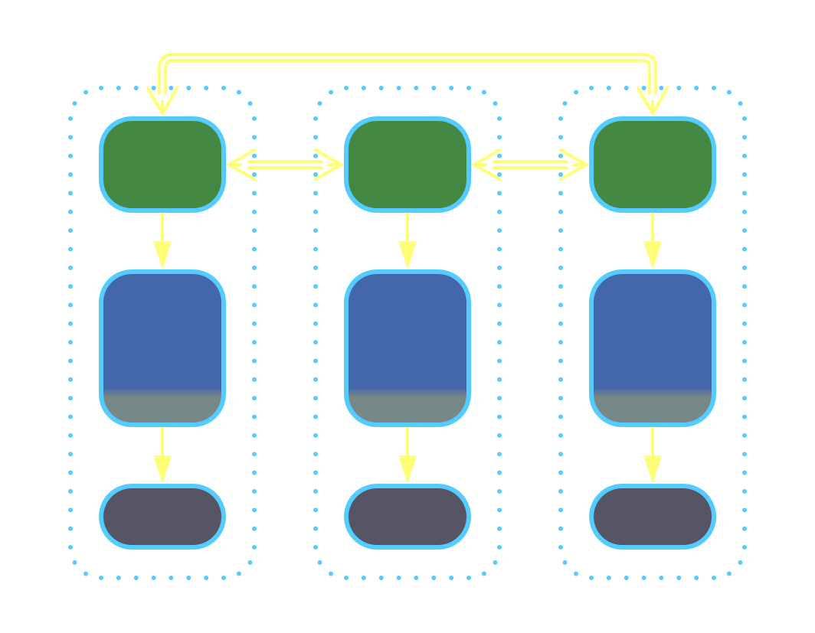
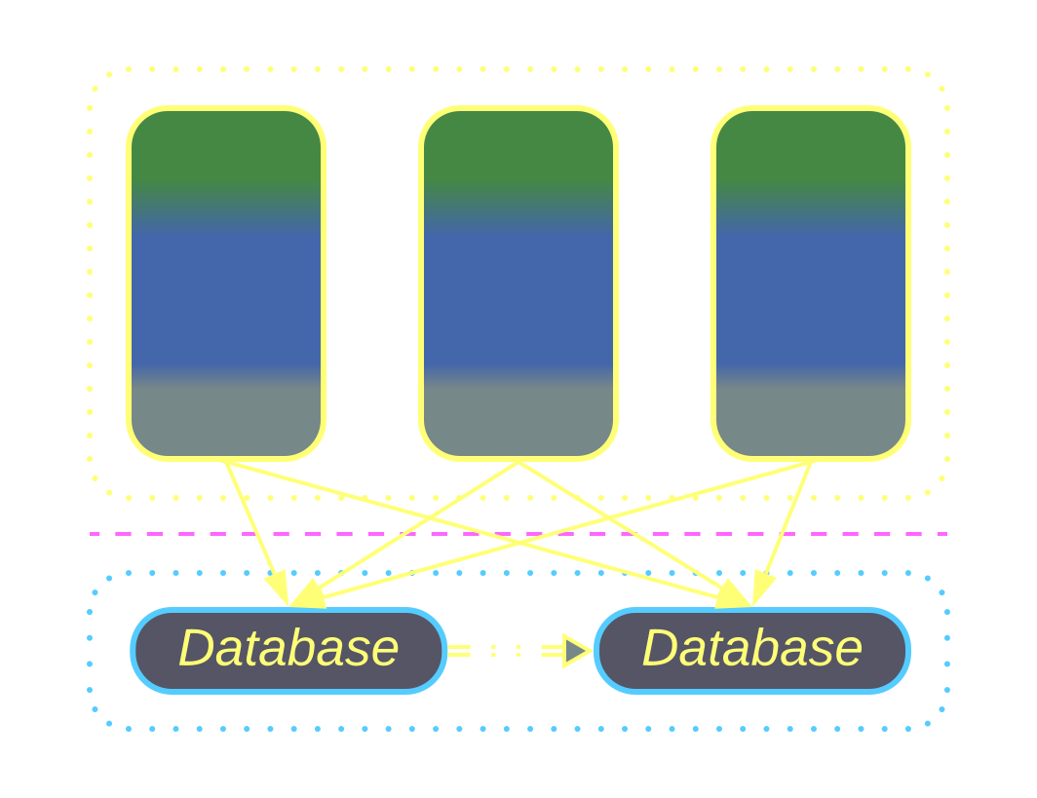
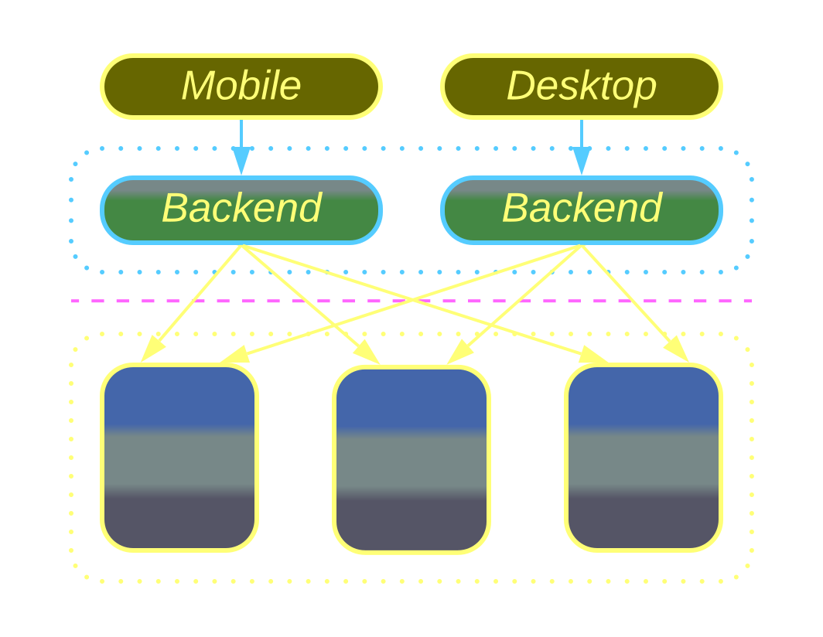
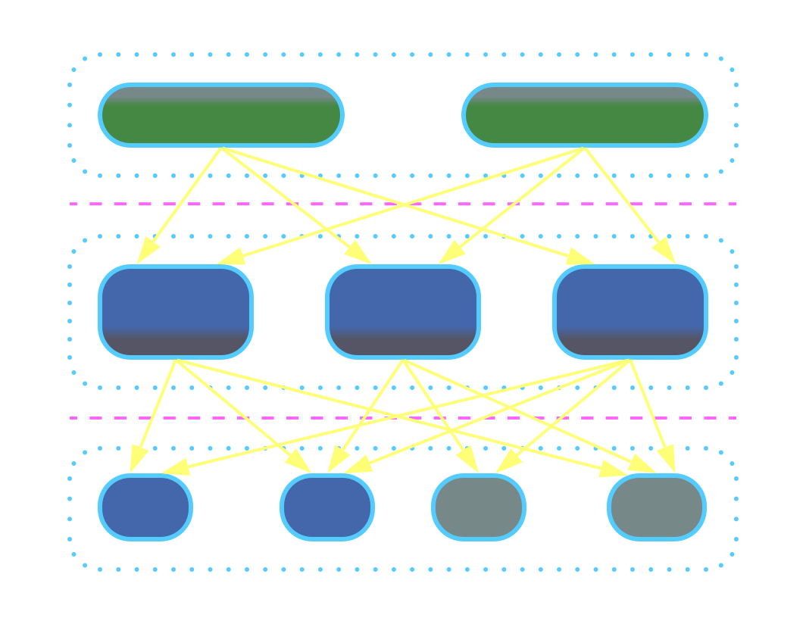
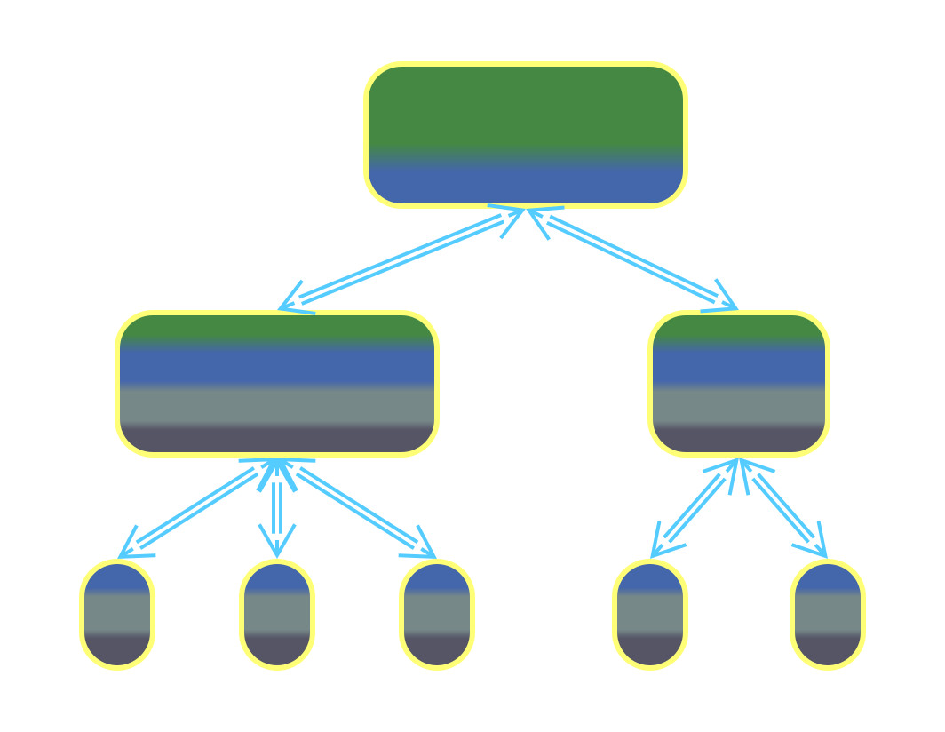
Fragmented Metapatterns
Layered Services | Polyglot Persistence | Backends for Frontends | SOA | Hierarchy
Orchestrated 3-Layered Services, Choreographed 2-Layered Services, CQRS | Specialized Databases, CDN, Read-Only Replicas, Reporting Database | Multiple Proxies, Orchestrators or API Gateways | Enterprise SOA, Domain- Oriented Microservice Architecture, Distributed Monolith | Top-Down Hierarchy, PAC, HMVC, Bus of Buses, WSO2 Cell-Based Architecture
Notes:
These are architectures built from relatively small components https://metapatterns.io/fragmented-metapatterns/

Slide 23
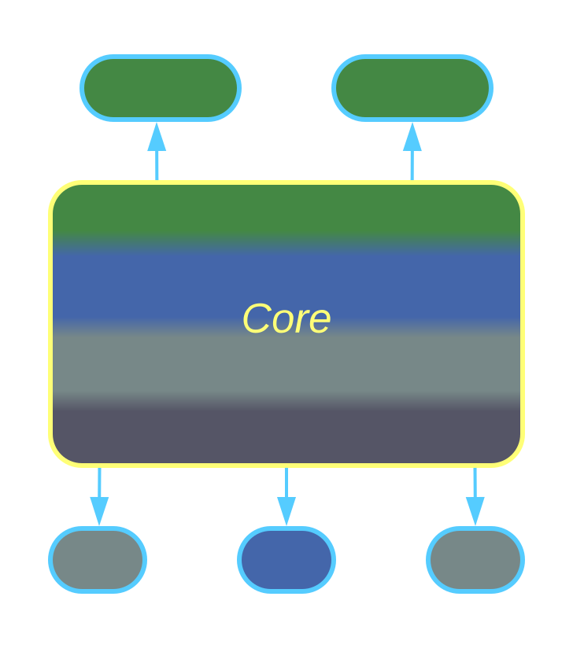
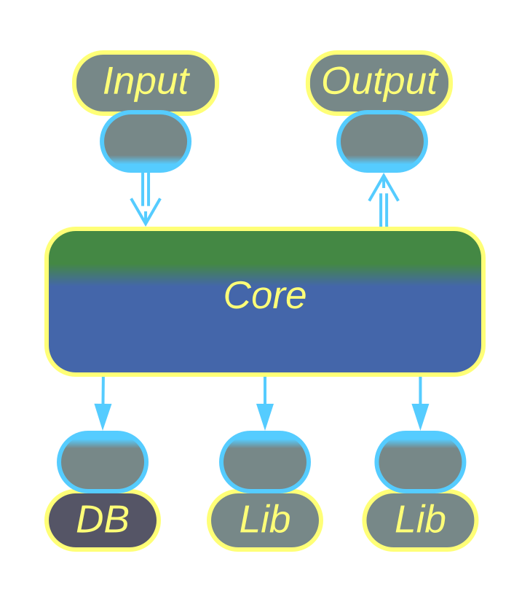
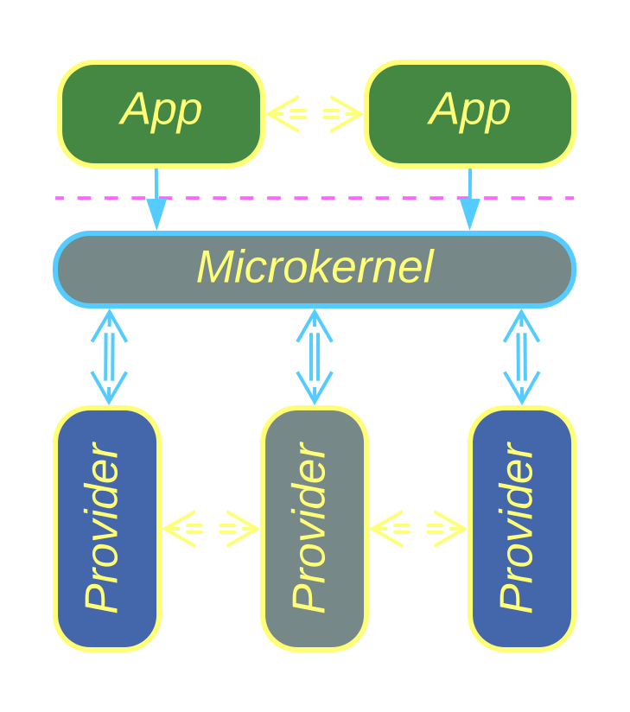
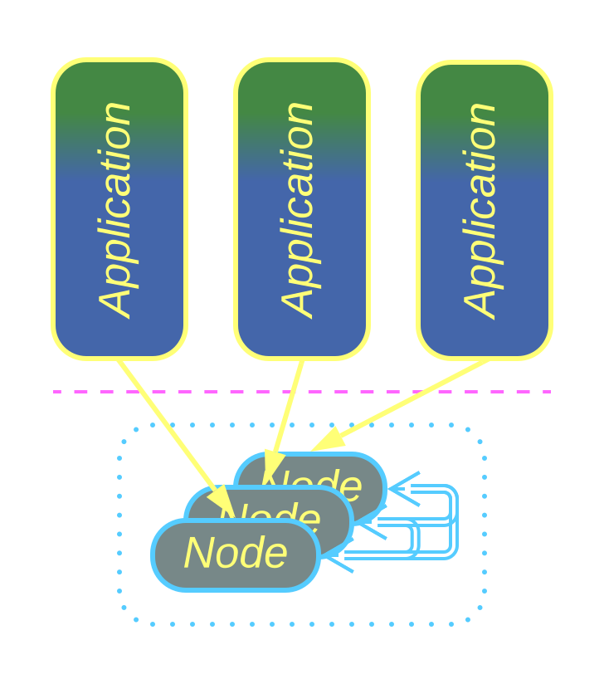
Implementation Metapatterns
Plugins | Hexagonal Architecture | Microkernel | Mesh
Plugins, Addons, Strategy, Hooks, Aspects, Reflection | Ports and Adapters, Onion Architecture, MVC family, MVP family | OS, Software Framework, Hypervisor, Interpreter, Saga Engine | P2P Network, Actors, Service Mesh, Space-Based Architecture
Notes:
These architectures take a look inside a system component https://metapatterns.io/implementation-metapatterns/

Slide 24
Conclusion

Slide 25
Limitations
The structural approach works only for system-wide architectural patterns:
– No Gang of Four design patterns
– No Enterprise Integration patterns
– No TDD organizational patterns
The research is in its early phase and is not supported by any organization.
Notes:
There is the bus factor and lack of funding.

Slide 26
Links
My book Architectural Metapatterns is available:
– for reading online at metapatterns.io
– as an ebook from leanpub.com/metapatterns
The diagrams and the ODT source file are provided under the CC BY license.
This book is a seminal research on reframing patterns.
It’s up to you to see to it being recognized or discarded.
Notes:
I am out of options to promote the book and its ideas. If you spread the word about it, it may survive and help people see the big picture behind patterns.

